Slide 1
SWOLE Team 6 Game Concepts

Slide 2
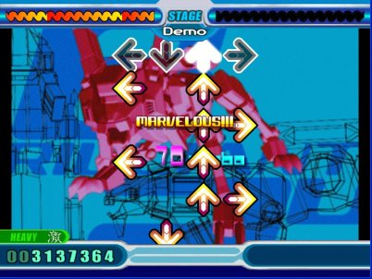
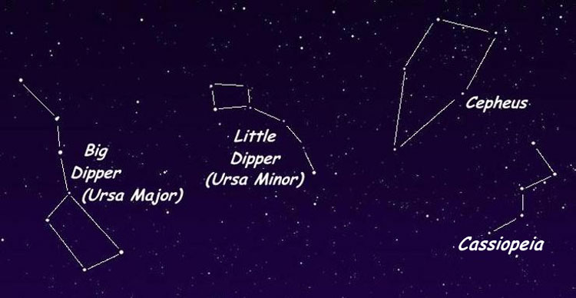
1st concept: Rhythm-based constellations
Form different constellation shapes to the beat of the game music
Player’s mouse travels from star-to-star, making them glow brighter and forming lines between them
Possibly have puzzles where players must select stars in a certain path to hit them all

Slide 3
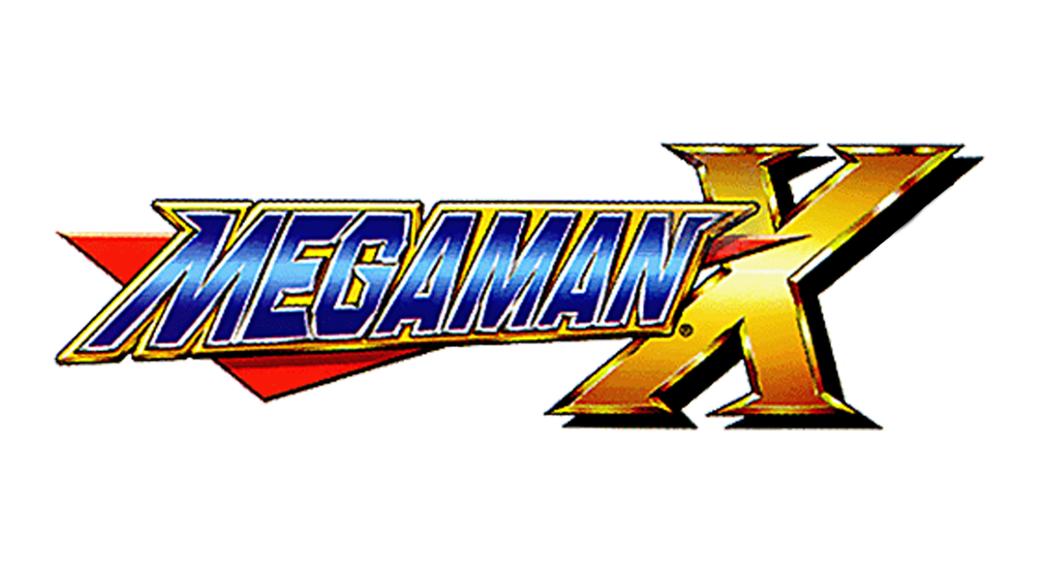
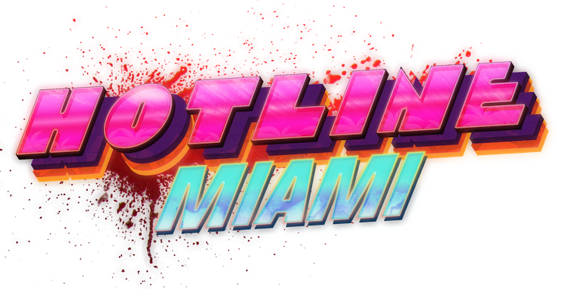
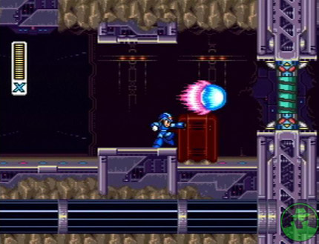
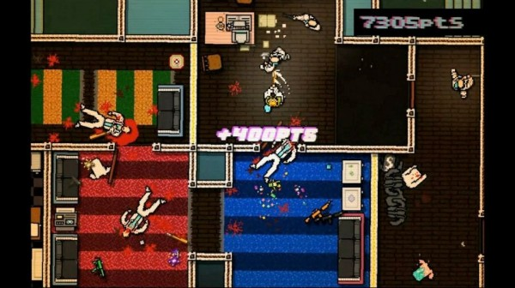
2nd concept: Fast-paced shooter/platformer
In the style of Mega Man, but with the speed and intensity of Hotline Miami
Swarm the player with tons of enemies to mow down
Multiple weapons to pick from with varying ways of clearing a path to the end of each level

Slide 4

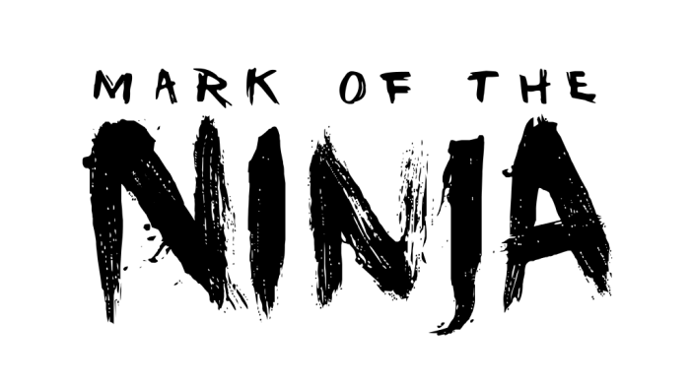
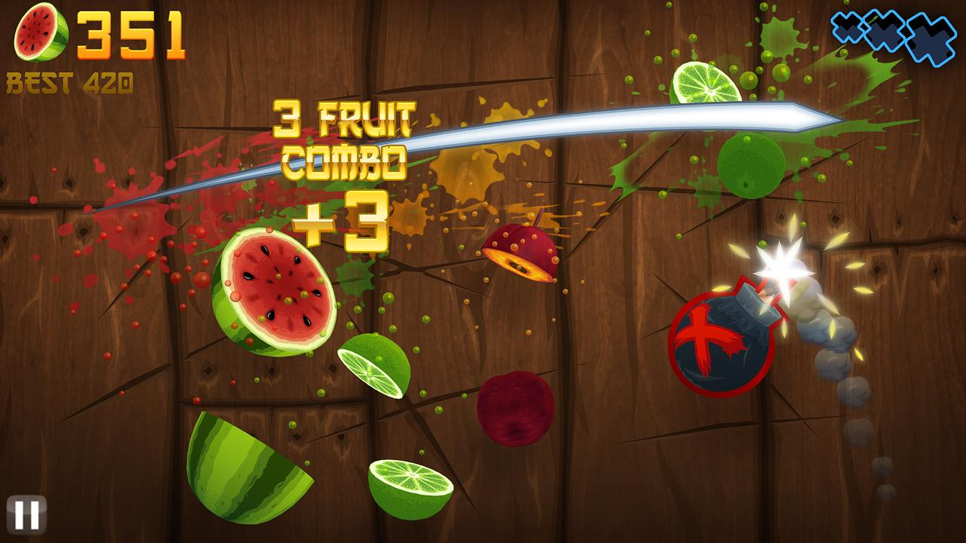
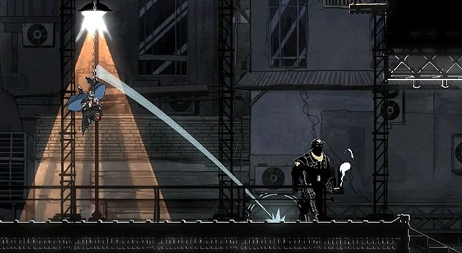
3rd concept: Hack & Slash Platformer
Side scrolling swordsman game that could either be stealthy or combat-heavy
All character attacks are controlled by the player clicking and dragging their mouse over enemies to slash at them
Successful attacks can combo into super attacks with their own mouse movements

Slide 5
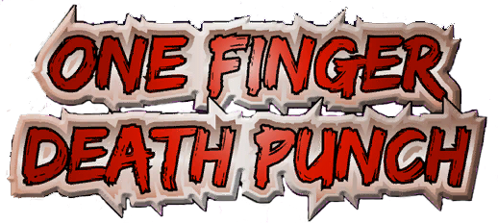
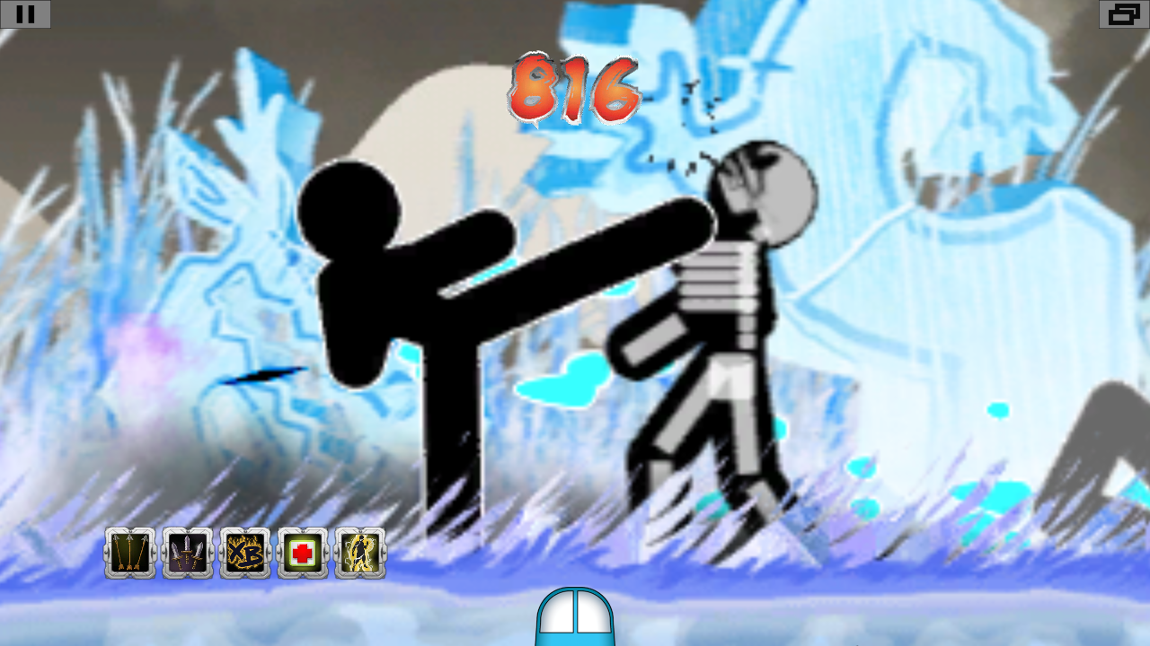
Final Decision: Fast-paced Hack & Slash
Combine the frantic, fast-paced action of Hotline Miami and One Finger Death Punch with the slashing mechanic of Fruit Ninja
Attack combos that give the player energy to use power attacks
Unlockable powers and passive abilities for players to customize how they play

